Slide 1
Music Generation using RBM and TensorFlow
Pranav Swaminathan
Shruti Mehta
https://github.com/MehtaShruti

Slide 2
Introduction
involves the generation of music by training the Restricted Boltzmann Machine model using RNN
Data is a set of homogeneous instrumental music to produce new music
The technique can give some appreciable results, but music is more complex than a series of strict rules
propose the use of a new machine learning model that has been specially designed to learn time sequence phenomenon

Slide 3
Motivation
The datasets in real life are much more complex
More challenging when the data is in an unstructured format such as image or audio
Having inspired by music and having decent understanding of music theory, we were motivated to work on this project
Music theory (sheets) – notes are related to each other.
These notes are just ways to mapping out pitches or sound waves

Slide 4
Audio Data
Directly or indirectly, we are always in contact with audio
simple example can be your conversations with people which you do daily
So, can you somehow catch this audio floating all around you to do something constructive?
Yes, of course! There are devices built which help you catch these sounds and represent it in computer readable format.
Examples of these formats are wav, mp3, wma, midi

Slide 5
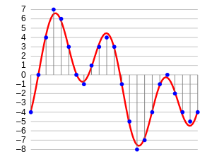
Audio wave

Slide 6
Musical Instrument Digital Interface (midi)
MIDI isn't music
MIDI doesn't contain any actual sounds
MIDI isn't a digital music file format like MP3 or WAV
MIDI is nothing more than data -- a set of instructions
MIDI data contains a list of events or messages that tell an electronic device (musical instrument, computer sound card, cell phone, et cetera) how to generate a certain sound

Slide 7
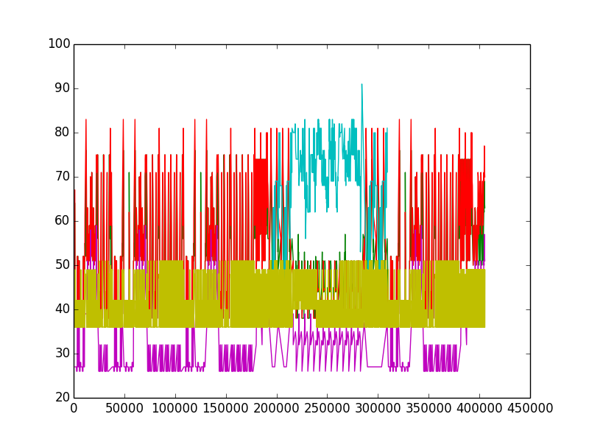

Slide 8
Train Data (.midi)
Our training data will be around a hundred MIDI files of pop songs (MIDI is a format that directly encodes musical notes)
To keep it simple, we won’t label them with emotions, our output will be another pop melody, just like our training files.

Slide 9
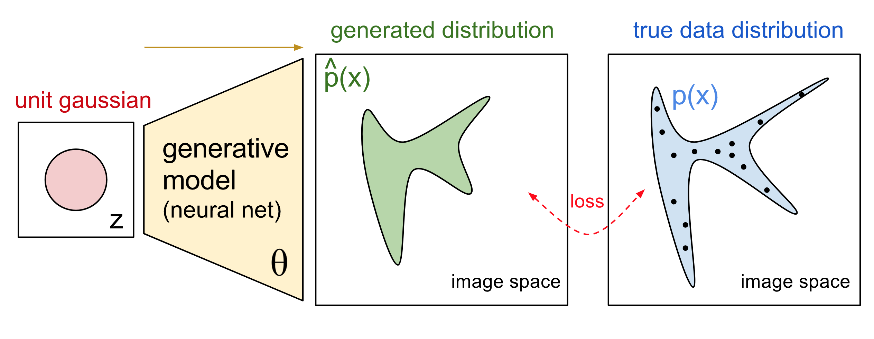
Generative Models
It is a model that allows us to learn simulator of data
An approach for unsupervised learning of data
Generative models are typically probabilistic, specifying a joint probability distribution over observation and target (label) values
Since, we are going to use a generative model, we can generate new samples directly by sampling from the modelled probability distribution

Slide 10
Sound from Recurrent Neural Networks
Audio generation seems like a natural application of recurrent neural networks, which are currently very popular (and effective) models for sequence-to-sequence learning
They have been used in speech recognition and speech synthesis

Slide 11
Restricted Boltzmann Machine
a generative stochastic artificial neural network that can learn a probability distribution over its set of inputs
RBMs are generative models that directly model the probability distribution of data

Slide 12
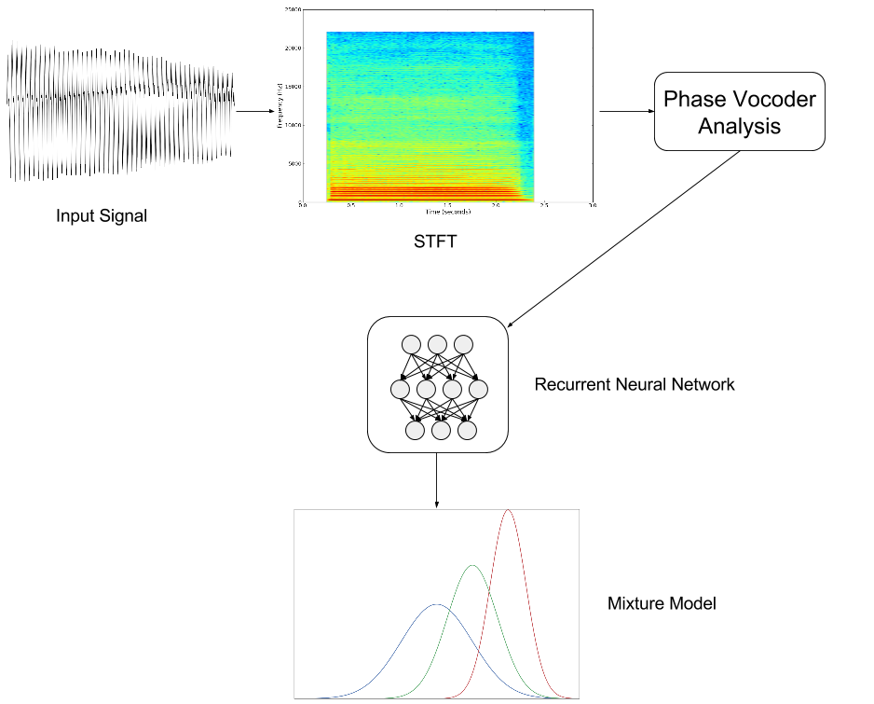

Slide 13

Python Libraries
TensorFlow™ is an open source software library for numerical computation using data flow graphs.
Nodes in the graph represent mathematical operations, while the graph edges represent the multidimensional data arrays (tensors)
communicated between them.

Slide 14
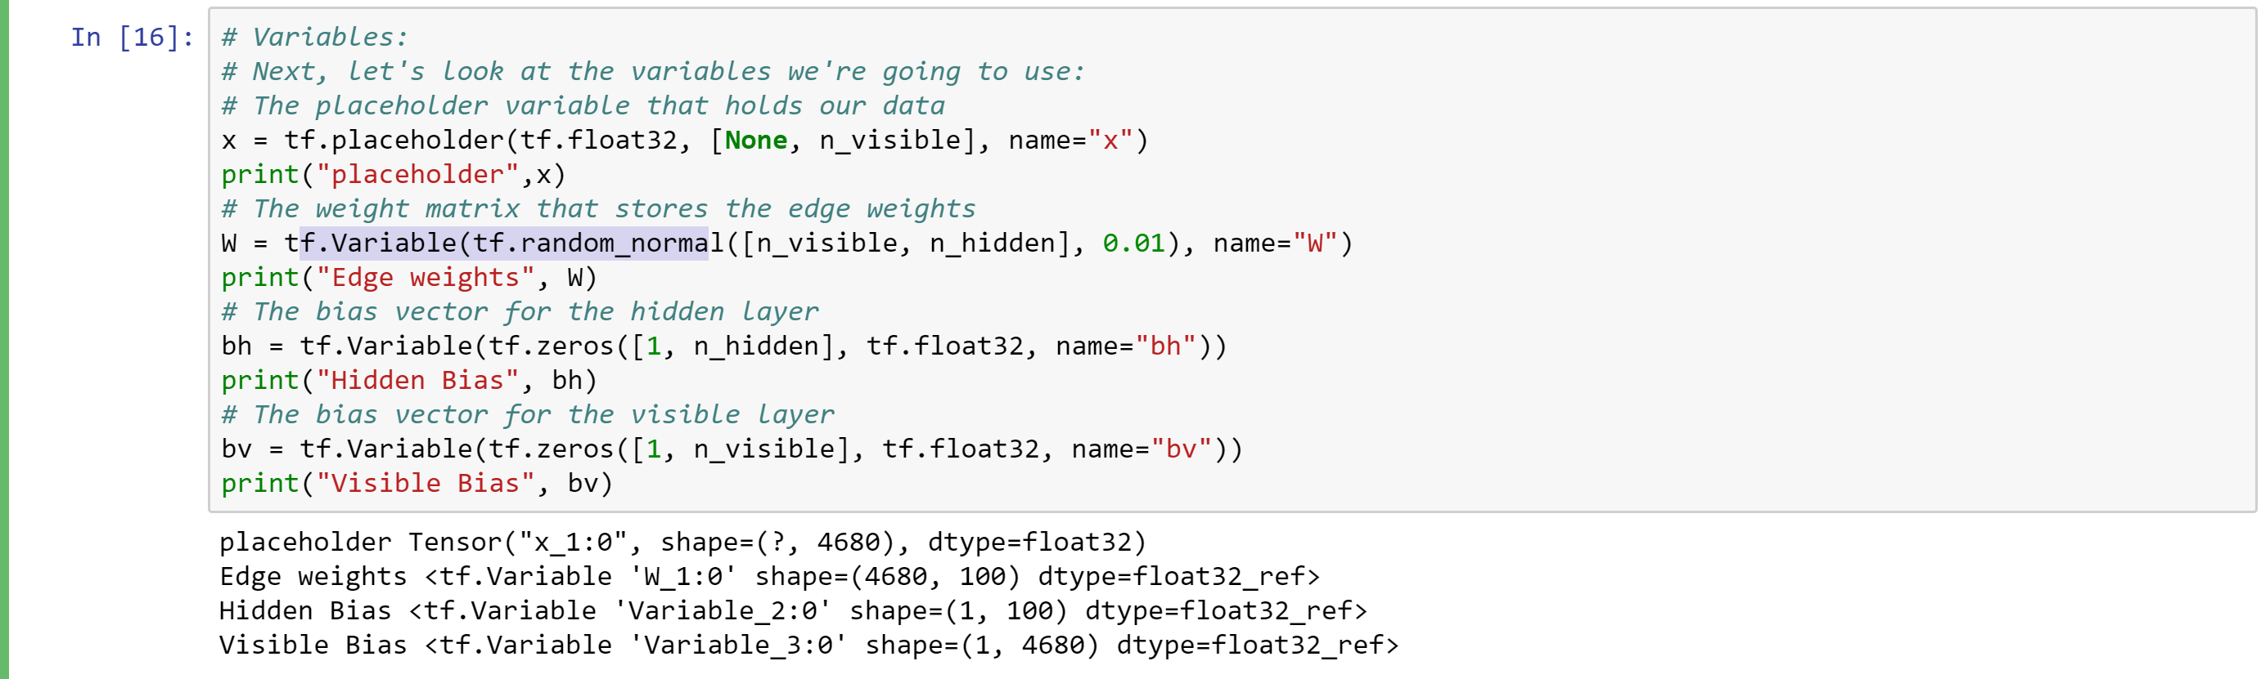
Initialising the parameters in TensorFlow

Slide 15
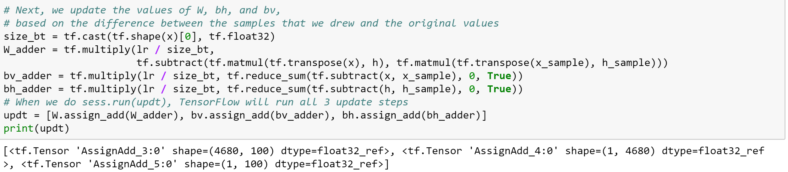
Updating the input parameters based on the difference between the samples that we drew and original values

Slide 16
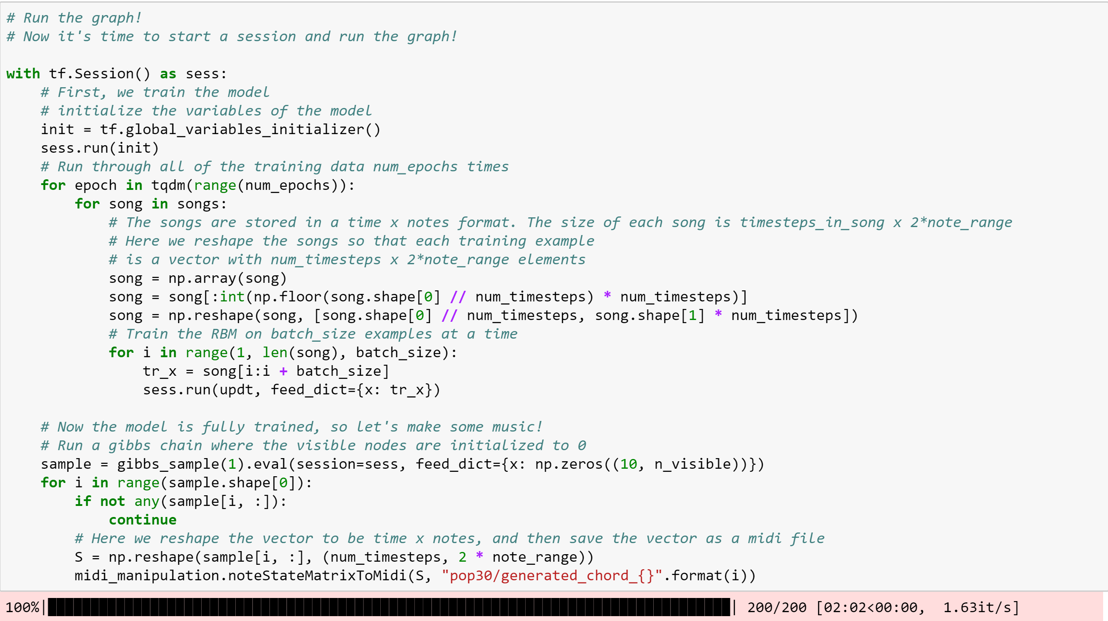
Training the model by using each music file (.midi) as input

Slide 17
References
https://medium.com/@oktaybahceci/generate-music-with-tensorflow-midis-4bf928a35c3a
https://www.reddit.com/r/datasets/comments/3akhxy/the_largest_midi_collection_on_the_internet/
https://www.analyticsvidhya.com/blog/2017/08/audio-voice-processing-deep-learning/
Youtube
https://www.youtube.com/watch?v=pg9apmwf7og&t=721s

